Slide 1


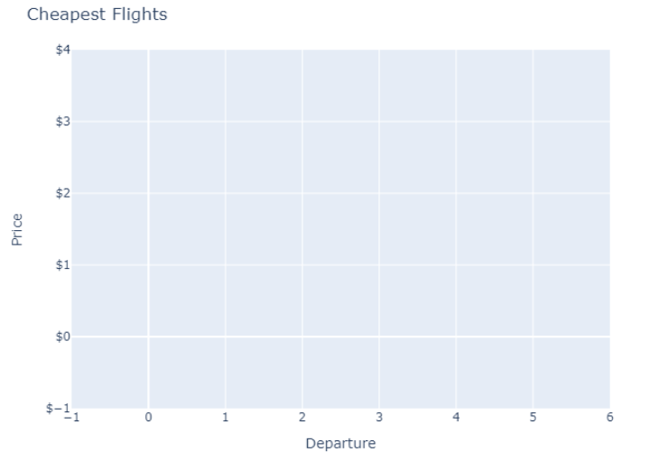

Where to?
A Python program that scraped the web to find each fights to multiple destinations for those occasions when do not know where you want to go. All you know is you want experience the world.
The script used inputs like departure location, flexible travel dates, and multiple destination inputs. It will output a clear graph that shows the cheapest options and a data frame listing the options (WIP).
GitHub Repository
By: Tyler Johnson

